Slide 1

B.TECH FULL STACK WEB DEVELOPMENT PROJECT REVIEW
Clean Air Pharma
Cleanroom Environment and Air Quality Monitor
A full-stack web monitoring system designed to track, evaluate, and persist critical cleanroom parameters in real time using Express.js, Socket.IO, React, and PostgreSQL.
Pharmaceutical Cleanroom Grade B / ISO Class 7 Monitoring
PROJECT GUIDE
STUDENT TEAM • TEAM NO: 18
Dr. Karumuri Sri Rama Murthy
1. 2520040035 – K. Harshit
2. 2520040046 – N. Karthik Ram Prasad
3. 2520049126 – M. Tirumala Teja
Department of Computer Science & Engineering
Koneru Lakshmaiah Education Foundation (KLU Hyderabad)
Assistant Professor
Department of CSE
KLU Hyderabad, Hyderabad

Slide 2
01. EXECUTIVE SUMMARY
Abstract
High-level project scope, purpose, and architecture overview
Cleanroom Monitoring Context
Full-Stack Solution & Scope
Controlled Cleanroom Environment: Pharmaceutical cleanrooms require strict, continuous environmental control to protect sterile drug products from contamination.
Key Monitored Parameters: Continuous observation of Temperature, Humidity, CO2, PM2.5, PM10, Differential Pressure, VOC, and Particle Count is critical.
Challenges with Manual Logging: Periodic manual clipboard recording makes it difficult to detect sudden air quality excursions or HVAC failures in real time.
Web-Based Real-Time Dashboard: CleanAir-Pharma provides a centralized web dashboard to view live environmental readings with zero page refreshes.
Full-Stack Architecture: Combines a responsive frontend, an Express.js backend API, and a PostgreSQL database for structured telemetry persistence.
Alerts & Extensibility: Automatically tags conditions as NORMAL, WARNING, or CRITICAL and can be extended with physical IoT sensors.
Goal: Make environmental cleanroom telemetry easily accessible, visual, and traceable for review without claiming formal regulatory certification.
Clean Air Pharma: Cleanroom Environment and Air Quality Monitor
KLU Hyderabad • Department of CSE • Team No: 1
Slide 2 of 12

Slide 3
02. BACKGROUND & CHALLENGES
Problem Description
Operational limitations and data risks in conventional cleanroom facilities
01
02
03
Strict Environmental Standards
Manual Logging Delays
Lack of Centralized Insights
• Cleanrooms require constant control over particulate matter, humidity, and pressure.
• Minor drifts in temperature or air pressure can compromise sterile medicine batches.
• Cleanroom Grade B / ISO Class 7 facilities require regular, multi-zone parameter validation.
• Manually recording gauge values takes excessive operator time every 1–2 hours.
• Excursions occurring between manual checks can remain unnoticed for hours.
• Paper logs are susceptible to recording errors, illegibility, and potential data loss.
• Separate wall meters do not aggregate telemetry into a single unified screen.
• Difficult to perform historical root-cause analysis without searchable database records.
• Facility managers lack instant notifications when air parameters breach safety zones.
The CleanAir-Pharma Solution: Replaces scattered manual clipboard inspections with an automated full-stack web dashboard that continuously ingests, evaluates, stores, and displays cleanroom air telemetry.
Clean Air Pharma: Cleanroom Environment and Air Quality Monitor
KLU Hyderabad • Department of CSE • Team No: 1
Slide 3 of 12

Slide 4
03. PROJECT GOALS
Project Objectives
Core milestones and engineering requirements achieved in the system
01
User-Friendly Dashboard
02
Multi-Parameter Display
03
Relational Data Storage
Develop an intuitive, responsive web dashboard showing cleanroom metrics clearly across desktop and mobile workstations without clutter.
Present 8 key environmental parameters (Temp, Humidity, CO2, PM2.5, PM10, Pressure, VOC, Particle Count) with clear status tags.
Persist all cleanroom sensor metadata, continuous time-series telemetry readings, and alert logs into a robust PostgreSQL database.
04
Historical Telemetry Review
05
Automated Excursion Alerts
06
Extensible IoT Architecture
Provide operators and auditors with queryable historical telemetry records, time-window filtering, and structured CSV export capability.
Evaluate incoming readings against configurable threshold matrices to generate and display NORMAL, WARNING, or CRITICAL alerts instantly.
Design a decoupled backend architecture so physical IoT microcontrollers (ESP32 via MQTT) can be attached later without rewriting the frontend.
Clean Air Pharma: Cleanroom Environment and Air Quality Monitor
KLU Hyderabad • Department of CSE • Team No: 1
Slide 4 of 12

Slide 5
04. TECHNICAL ARCHITECTURE
Technologies Used
Technologies, libraries, and database systems verified in the project implementation
FRONTEND STACK
BACKEND & MIDDLEWARE
DATABASE PERSISTENCE
React 19 & TypeScript
Component-based UI with strict compile-time type safety.
Vite 8
Next-generation build tool and rapid development server.
Tailwind CSS
Responsive industrial dark layout optimized for cleanroom screens.
Recharts
High-frequency telemetry trend visualization and SVG charts.
Socket.IO Client & Axios
Real-time WebSocket events and REST communication.
Node.js Runtime
Asynchronous, event-driven engine for non-blocking I/O.
Express.js Framework
Robust RESTful API architecture and request validation.
Socket.IO Server
Sub-second real-time telemetry streaming to browsers.
JWT & bcryptjs
Password hashing and multi-tier Role-Based Access Control.
Polymorphic Ingestion Engine
Decoupled SensorDataSource supporting Simulation and MQTT.
PostgreSQL 18
Battle-tested relational database running on Port 5432.
5 Relational Tables
users, sensors, sensor_readings, alerts, and threshold_config.
Connection Pooling (pg.Pool)
High-concurrency query execution with automatic retry.
Composite Indexes
Indexed (sensor_id, timestamp) for rapid historical queries.
Self-Healing Initialization
Auto-provisions database schema and seeds demo baselines.
Clean Air Pharma: Cleanroom Environment and Air Quality Monitor
KLU Hyderabad • Department of CSE • Team No: 1
Slide 5 of 12

Slide 6
05. SYSTEM ARCHITECTURE
System Architecture Diagram
End-to-end data flow connecting telemetry ingestion, backend processing, database, and UI
INGESTION SOURCE
NODE.JS & EXPRESS BACKEND CORE
REACT 19 FRONTEND
Simulated Sensor Data
(Markovian Random Walk)
• Generates 8 realistic cleanroom metrics every 3 seconds
• Brownian drift with mean-reversion stability
• Interactive spike triggers for testing alert limits
• Future: MQTT Broker (ESP32 microcontrollers)
Processing & Evaluation Engine
• Validates incoming sensor packets
• Evaluates thresholds (NORMAL / WARNING / CRITICAL)
• Alert deduplication engine (60s cooldown tracker)
• REST Endpoints: /api/sensors, /readings, /alerts, /auth
Persistence Engine (Port 5432)
• PostgreSQL Connection Pool (pg.Pool)
• Inserts readings into sensor_readings & alerts
• Auto-provisioning database migration manager
Real-Time Dispatcher (Socket.IO)
• Pushes readings_update event to connected clients
Interactive Dashboard
(Port 5173)
• 8 Sensor telemetry cards with status indicators
• Global Cleanroom Status banner (NORMAL / CRITICAL)
• High-frequency Recharts telemetry curves
• Role-Based Access Control (Admin, Operator, Viewer)
• Historical logs & CSV export
Telemetry
Packets
Socket.IO
& REST
Clean Air Pharma: Cleanroom Environment and Air Quality Monitor
KLU Hyderabad • Department of CSE • Team No: 1
Slide 6 of 12

Slide 7
06. OPERATIONAL LIFECYCLE
Working Process
5-stage continuous pipeline from telemetry generation to real-time client visualization
STAGE 1
STAGE 2
STAGE 3
STAGE 4
STAGE 5
Telemetry Ingestion
Backend Processing
Database Persistence
Socket.IO Broadcast
Dashboard Display
• Readings are generated via Markovian random walk every 3 seconds.
• Simulates 8 cleanroom parameters across designated facility zones.
• Pluggable interface ready for MQTT microcontrollers.
• Express server receives the telemetry packet.
• Compares live readings against threshold_config matrix.
• Determines parameter safety state (NORMAL, WARNING, CRITICAL).
• Telemetry records committed to sensor_readings table.
• If parameter breaches threshold, an excursion alert is logged in alerts table.
• Deduplication prevents repeated alert logging.
• Backend broadcasts readings_update event over WebSocket.
• Connected browser clients receive packet simultaneously in sub-second time.
• No page refreshes or HTTP polling required.
• React state updates live parameter cards with current values and units.
• Global cleanroom status banner automatically adapts.
• Recharts graphs plot new real-time data points smoothly.
Clean Air Pharma: Cleanroom Environment and Air Quality Monitor
KLU Hyderabad • Department of CSE • Team No: 1
Slide 7 of 12

Slide 8
07. CODEBASE IMPLEMENTATION
Implementation Details
Technical organization across the Frontend, Backend, and Database subsystems
Frontend Subsystems
Backend Subsystems
Database Subsystems
Modular UI Architecture:
Built with dedicated React components for SensorCard, StatusBanner, Navigation bar, and Sidebar.
Global Authentication Context:
AuthContext manages user session state, JWT tokens, and Remember Me preferences.
Protected Route Guards:
ProtectedRoute redirects unauthenticated visitors to /login and enforces RBAC restrictions.
Live Telemetry Visualization:
Recharts SVG curves plot rolling time-series telemetry with dynamic warning/critical threshold lines.
Service-Layer Separation:
Clean separation across ReadingService, AlertService, SensorService, and AuthService.
Alert Engine Deduplication:
Internal state tracking suppresses alarm spamming within a 60-second cooldown window.
RESTful API Routing:
Structured endpoints with HTTP status codes and middleware validation.
Resilient Dual-Mode Storage:
Seamlessly commits to PostgreSQL while maintaining in-memory fallback buffers for zero downtime.
Relational Schema Design:
5 structured tables (users, sensors, sensor_readings, alerts, threshold_config).
Foreign Key Integrity:
sensor_readings references sensors(sensor_id) with ON DELETE CASCADE constraints.
Time-Series Optimization:
Composite B-tree indexes on (sensor_id, timestamp DESC) for instantaneous range retrieval.
Auto-Provisioning Engine:
Database manager automatically creates cleanair_pharma and seeds baseline data on startup.
Clean Air Pharma: Cleanroom Environment and Air Quality Monitor
KLU Hyderabad • Department of CSE • Team No: 1
Slide 8 of 12

Slide 9
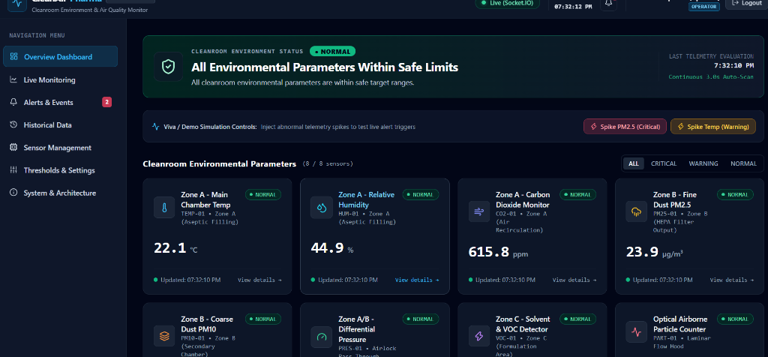
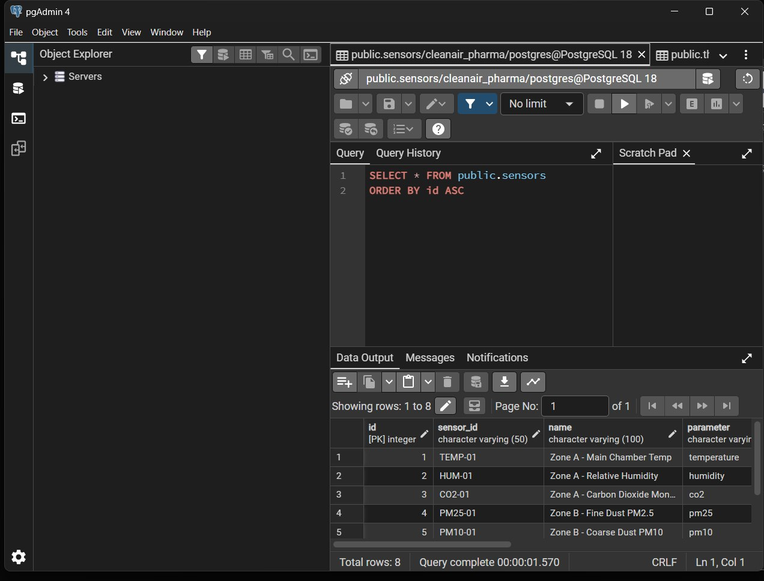
08. VERIFIED LIVE SCREENSHOTS
Application Output Screens
Real application output captured directly from the running project deployment
CleanAir-Pharma Live Monitoring Dashboard
PostgreSQL 18 Database in pgAdmin 4
Key Demonstrations:
• Real-time observation of 8 cleanroom parameters (Temp 22.1°C, Humidity 44.9%, CO2 615.8ppm).
• Overall status banner (NORMAL), Socket.IO live indicator, Operator role badge, and spike controls.
Key Demonstrations:
• Verified cleanair_pharma relational database running on PostgreSQL 18 (Port 5432).
• 5 verified tables: alerts, sensor_readings (2,240+ readings logged), sensors, threshold_config, users.
Clean Air Pharma: Cleanroom Environment and Air Quality Monitor
KLU Hyderabad • Department of CSE • Team No: 1
Slide 9 of 12

Slide 10
09. EMPIRICAL VALIDATION
Testing and Observations
Verified test cases conducted directly on the full-stack application and database
Test Area | Test Scenario | Expected Result | Actual Observed Result | Status
Frontend UI | Vite Client Boot | Loads on Port 5173 with dark industrial theme | Loaded in 234ms; responsive across desktop & mobile | PASS
Backend API | Health REST Endpoint | GET /api/health returns healthy subsystem state | HTTP 200 OK; reports database connected, 8 sensors | PASS
Database | PostgreSQL Connectivity | Node connects to Port 5432 (cleanair_pharma) | Connected successfully; all 5 tables auto-verified | PASS
Telemetry | Real-Time Ingestion | Readings continuously saved to sensor_readings | Over 2,240 records logged with timestamps every 3s | PASS
Alert Engine | Threshold Excursion | Spiked values trigger WARNING / CRITICAL alerts | Alert generated, deduplicated, and pushed via Socket.IO | PASS
Security | JWT Auth & RBAC | Enforces role permissions (Admin, Operator, Viewer) | Bcrypt verification passed; route protection confirmed | PASS
Testing Observations & Findings:
1. Socket.IO pushes updates with sub-50ms latency across browser clients.
2. PostgreSQL connection pool smoothly handles continuous telemetry inserts while serving concurrent historical queries.
3. Authentication correctly rejects unauthorized modifications to sensors or thresholds.
Clean Air Pharma: Cleanroom Environment and Air Quality Monitor
KLU Hyderabad • Department of CSE • Team No: 1
Slide 10 of 12

Slide 11
10. SCALABILITY & ROADMAP
Future Enhancements
Planned technical expansions, hardware integrations, and intelligence capabilities
01
Physical Industrial IoT Sensors (Hardware)
02
Multi-Channel Emergency Alarms (Notifications)
• Connect physical ESP32 or Raspberry Pi microcontrollers via industrial MQTT.
• Interface with physical BME280 (Temp/Humidity/Pressure) and optical dust counters (PMS5003).
• Demonstrates seamless transition from simulation to field hardware.
• Integrate Twilio SMS API and SendGrid Email dispatch for critical excursions.
• Automated duty-officer call tree when differential pressure drops below limit.
• Push notifications for cleanroom managers on mobile devices.
03
AI-Powered Anomaly Forecasting (Machine Learning)
04
Multi-Facility Cleanroom Mapping (Enterprise)
• Implement predictive machine learning models using historical telemetry trends.
• Forecast HEPA filter degradation and airflow blockages before threshold breaches occur.
• Proactive HVAC maintenance recommendations.
• Expand database schema to manage multiple rooms (Zone A, B, C, Airlocks, Pass-Throughs).
• Interactive 2D cleanroom floorplan with color-coded live risk zones.
• PDF compliance report generation for audits.
Clean Air Pharma: Cleanroom Environment and Air Quality Monitor
KLU Hyderabad • Department of CSE • Team No: 1
Slide 11 of 12

Slide 12
11. PROJECT SUMMARY & CLOSING
Conclusion
Summary of achievements, technical impact, and acknowledgments
Key Project Takeaways & Impact
THANK YOU!
Centralized Cleanroom Supervision:
Eliminated reliance on manual clipboard records by creating an automated, unified telemetry monitoring dashboard.
Modern Full-Stack Integration:
Successfully connected React 19, Node.js, Express, Socket.IO, and PostgreSQL 18 into a reliable, low-latency pipeline.
Real-Time Air Quality Awareness:
Continuous evaluation of 8 critical parameters with instant visual status tagging and automated excursion alerts.
Academic Honesty & Extensibility:
Clearly documented simulation mechanism with a decoupled, MQTT-ready architecture built for future physical sensor deployments.
Questions & Discussion
Clean Air Pharma: Cleanroom Environment & Air Quality Monitor
Project Guide:
Dr. Karumuri Sri Rama Murthy
Assistant Professor, Dept. of CSE
Student Team (Team No: 1):
• K. Harshit (2520040035)
• N. Karthik Ram Prasad (2520040046)
• T. Teja Naidu (2520049126)
Department of Computer Science & Engineering
KLU Hyderabad, Hyderabad
Clean Air Pharma: Cleanroom Environment and Air Quality Monitor
KLU Hyderabad • Department of CSE • Team No: 1
Slide 12 of 12

